Slide 1

AfNOG 12
Dar-es-salaam, Tanzania
May 2011
Cleven Mmari
based on Hervey Allen’s template

Slide 2
Introduction
OpenNMS: a network management tool that actively monitors availability of devices and services using automated and directed discovery:
Gaining Popularity: a great open source networking and network management network software packages.
Portable: Uses JAVA, Postgress DB and runs in *nix, Windows and Macintosh (since ver 1.3.8 now at 1.8.12)
Scalable: Can support up to thousands of devices and services.
Modular: have a lot of plug-ins and you can easily define some

Slide 3
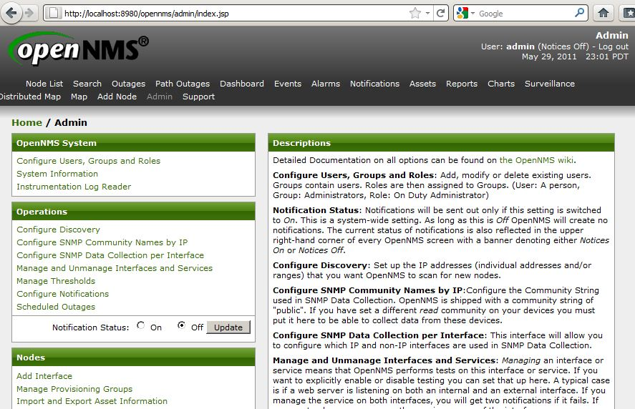
“Admin page Web Interface”

Slide 4
Features: 1
Modular
Type of availability is configured through
plug-ins:
  The product's architecture is simple enough that writing new plug-ins is fairly easy in the language of your choice.
  There are many, many, many plug-ins available.

Slide 5
Features: Plug-Ins or Modular
The openNMS package comes with a number of pre-installed plugins:
Automatic Layer-2 and Layer-3 link discovery; Automatic Network / Node Discovery and Provisioning;Automatic Service Discovery and Provisioning;Manual Node and Service Provisioning Groups;Path Outage support;Performance Data Collection Protocols:{HTTP,JMX,NSClient, NSClient++,SNMP}
Service Availability and Response Time Monitoring: {BGP sessions;Citrix Metaframe;Database: catalog retrieval, stored procedures (Oracle, Postgres, MySQL, SQL Server, others);Distributed monitoring available for most protocols;DHCP, DNS;FTP;General Purpose Monitor for small-scale monitoring via arbitrary commands;HTTP, HTTPS Response Code and Page Content Verification (on standard and non-standard ports);HTTP / HTTPS Page Sequence Monitoring (user simulation);ICMP Ping, StrafePing (similar to and inspired by SmokePing);LDAP, LDAPS;Mail: SMTP, POP3, IMAP, Lotus Domino IIOP;Mail Transport Monitor (round-trip SMTP - POP3/IMAP delivery test);Nagios Plugins (via NRPE), NSClient, NSClient++;Network Time Protocol (NTP);Passive (non-IP) services;RADIUS authentication;Remote CLI: SSH, Telnet;SNMP (any OID, scalar or tabular);Trivial time protocol (Unix, Windows);Windows services status There are many more available (e.g.)...
http://www.opennms.org/documentation/java-apidocs-stable/org/opennms/netmgt/capsd/plugins/package-summary.html

Slide 6
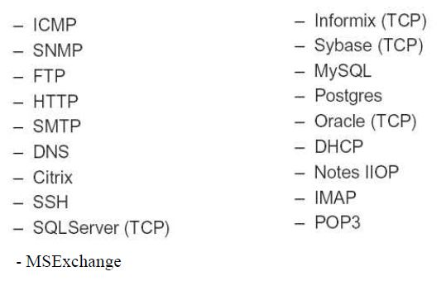
Services Available by Default

Slide 7
Features: 2
Portable and Scalable
Based in Java and use postgress DB
Available in *nix, Windows and MacOS

Slide 8
Feature 3
Automated and Directed Discovery
Add interfaces (IPs) and auto discover and monitor your network
Add define and add manually.

Slide 9
Components
• PostgreSql
• SNMP Stack
• Jrobin (http://www.jrobin.org/)
• Tomcat
• Castor: data binding framework for Java

Slide 10
The Three "Halves" of OpenNMS
Service Scanning: Is a given network service available?
SNMP Data Collection: Traditional network performance measurement via SNMP
Event Management and Notification

Slide 11
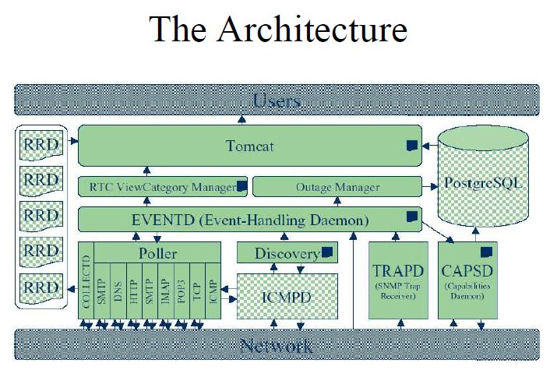

Slide 12
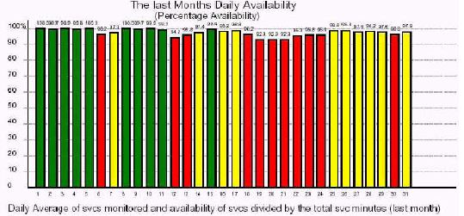
Now you can generate
“Availability Reports”

Slide 13
SNMP Data Collection
OpenNMS uses RRDtool (the end result of MRTG) to store and graph SNMP data.
Configurable: the polling interval, data collection and how the data is stored.
Custom Reports: Almost any report possible with RRDtool can be built into OpenNMS.

Slide 14
Data Collection Configuration example
<group name = "signalQuality_DOWN" ifType = "128">
<mibObj oid=".1.3.6.1.2.1.10.127.1.1.4.1.2" instance="ifIndex"
alias="sigQUnerroreds_DN" type="counter"/>
<mibObj oid=".1.3.6.1.2.1.10.127.1.1.4.1.3" instance="ifIndex"
alias="sigQCorrecteds_DN" type="counter"/>
<mibObj oid=".1.3.6.1.2.1.10.127.1.1.4.1.4" instance="ifIndex"
alias="sigQUncorrect_DN" type="counter"/>
<mibObj oid=".1.3.6.1.2.1.10.127.1.1.4.1.5" instance="ifIndex"
alias="sigQSignalNoise_DN" type="integer"/>
<mibObj oid=".1.3.6.1.2.1.10.127.1.1.4.1.6" instance="ifIndex"
alias="sigQMicroreflec_DN" type="integer"/>
</group>

Slide 15
Events and Notification
OpenNMS new versions (after 1.4.x) added maps.
Can receive both internal and external
(SNMP Trap) events. Automatic actions
can be built to execute on event reception.
Events can trigger Notifications
Notifications walk a "destination path" to insure that alerts reach the proper people.

Slide 16
Events configuration example
<event>
<mask>
<maskelement>
<mename>id</mename>
<mevalue>.1.3.6.1.4.1.9.9.33.2</mevalue>
</maskelement>
<maskelement>
<mename>generic</mename>
<mevalue>6</mevalue>
</maskelement>
<maskelement>
<mename>specific</mename>
<mevalue>2</mevalue>
</maskelement>
</mask>
<uei>uei.opennms.org/vendor/Cisco/traps/cipCsnaLlc2ConnectionLimitExceeded</uei>
<event-label>CISCO-CIPCSNA-MIB defined trap event: cipCsnaLlc2ConnectionLimitExceeded</event-label>
<descr>This trap indicates that a connection .....
</descr>
<logmsg dest='logndisplay'>&lt;p&gt;Cisco Event: Connection Limit Exceeded.&lt;/p&gt;</logmsg>
<severity>

Slide 17
Configuration Files
Located in $OPENNMS_HOME/etc
(http://www.opennms.org/wiki/Configuration_File_Index)
Important files include:
  javamail-configuration.properties The config file for email configuration
  opennms.properties Main configuration file.
  *.properties & *.properties All other configuration

Slide 18
Some References
  http://jeffgehlbach.com/?p=118
  OpenNMS project http://www.opennms.org

