Slide 1
AfNOG 2017
Track SI-E
Scalable Network Infrastructure

Slide 2
What you will learn
Internet Protocol stack
IP Addressing (IPv4 and IPv6)
Static routing
Dynamic routing with OSPF
Exterior routing with BGP
Router management
Network operations and management
Internet exchange points

Slide 3
Instructors
Frank Habicht (TZ)
Geert Jan de Groot (NL)
Maina Noah (TZ)
Nishal Goburdhan (ZA)
Sara Alamin Mohammed Hassan (SD)
Stephen Honlue (CM)

Slide 4
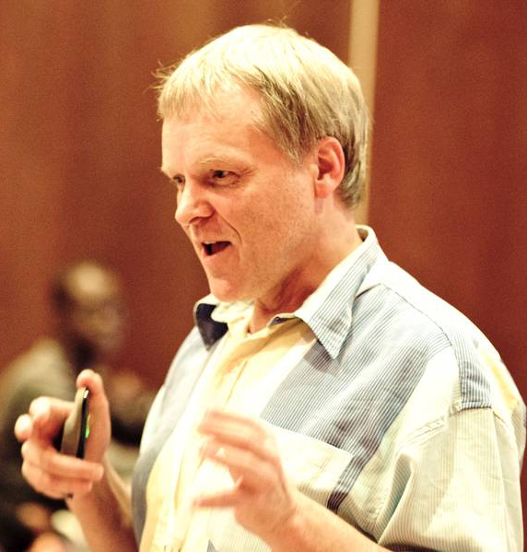
Alan Barrett

Slide 5
Participants
Entire Workshop:
150 participants
29 Countries
8 tracks
This track: 23 participants
Please introduce yourselves now.

Slide 6
Let us know …
… if we speak too fast
… if you can’t see
… if you don’t understand!
The only stupid question is one you don’t ask!

Slide 7
You should have received ..
Name badges (Please wear these at all times!)
Folder with:
Notepad
Pen
Information Pack

Slide 8
You will receive …
ebooks
workshop materials on USB flash drives
Take them back, and teach others!

Slide 9
Extra room charges
AfNOG will not pay for hotel “extras” such as:
telephone calls
room service
bar
mini-bar in your hotel room
laundry
etc..

Slide 10
Hotel Internet Access
Free WiFi at the hotel
SSID : BOMA

Slide 11
Internet access in classrooms
WiFi access should work on your personal devices.
SSID “AIS”
WPA-2 password “success!”
No charge
If you abuse this, you may be blocked!

Slide 12
Internet use in class
Please focus on the class (do not read email/browse the web during sessions).
You can download most of the training materials from the workshop website:
http://www.ws.afnog.org/afnog2017
> SI-E
> Detailed timetable

Slide 13
AfNOG electronic resources
Workshop web site
http://www.ws.afnog.org
During the workshop, this will contain a “work-in-progress” site.
After the workshop, it will contain a copy of the materials.
Mailing List
afnog@afnog.org
subscribe via https://www.afnog.org

Slide 14
Daily Schedule
06:30 – 08:15 Breakfast
08:30 – 10:30 Classroom session (2 h)
10:30 – 11:00 Tea/Coffee
11:30 – 13:00 Classroom session (1.5 h)
13:00 – 14:00 Lunch
14:00 – 16:00 Classroom session (2 h)
16:00 – 16:30 Tea/Coffee
16:30 – 18:00 Classroom session (1.5 h)
18:30 – 20:00 Dinner
20:00 - Optional Evening session

Slide 15
Time Keeping
Please be on time.
We have a lot of material to cover and we won’t be able to, if breaks get extended.
Latecomers may be refused re-admission !

Slide 16
Evening sessions
There might be optional evening sessions.
If you’d like us to cover a specific topic, please let us know (writing pad at the back)

Slide 17
Classroom layout
10 “cells” - labelled A,B,….J
Each cell has:
2 participants
1 PC running Linux/FreeBSD
1 Cisco router
Use the classroom WiFi to access the cloud.

Slide 18
Logical structure of each “cell”
Student
Student
Kbd/
mouse
Screen
gig1/0
FreeBSD/Linux
PC
em0
gig0/0
Router
gig2/0
console
gig3/0

Slide 19
Where are the routers and the PCs?
Virtual devices inside one or two real PCs with a lot of memory.
Special IP addresses and port numbers connect the outside world to the virutal devices.
Instructors can do things like connect the ethernet port of two virtual routers together, or connect the ethernet port of a PC to the ethernet port of a router.

Slide 20
Access to virtual PCs and Routers
Use VNC to a special hostname and port to connect to your virtual PC.
Use telnet to a special hostname and port to access the serial console of your virtual router.
See notes for details:
> SI-E,
> Details
> Monday morning session
> Equipment access details.

Slide 21
Install VNC and Telnet/SSH clients
Windows:
Search for “VNC viewer”. TightVNC or RealVNC are both fine
Search for “putty ssh”
Linux:
Install “vinagre” or any other VNC package
Telnet and SSH are built in
Mac:
VNC, Telnet and SSH are already built in

Slide 22
PC Configuration
Ubuntu Linux
“root” password is “afnog”
user “afnog” password is “afnog”
Do NOT change passwords
Do NOT patch security holes
Do NOT install DNS resolvers.

Slide 23
Open Questions
Please feel free to ask any questions during the sessions.
Please interrupt us if you don’t understand anything, or if you have a question.
Please ask questions :-)

Slide 24
WELCOME to AFNOG
Learn everything you can,
Have fun,
Take photos,
Network,
Ask questions, you’ll make the instructors happy.

