Slide 1
Static Routing Exercise
Scalable Infrastructure Workshop

Slide 2
What will the exercise involve?
Unix network interface configuration
Cisco network interface configuration
Static routes
Default route
Testing

Slide 3
Routing
Routing is done based on destination IP address
Without routing, an interface can only reach destinations that are on their local network segment.
A device with at least 2 interfaces can route

Slide 4
Routing
Static route
  specifically instructs router on which route to take to a particular destination network. This will almost always override anything else that the router knows.
Dynamic route
  learnt via routing protocols implemented on routers
Default route
  route that instructs a machine where to send packets for destinations that are not in the routing table. This is usually the 'last resort' that a router will take.

Slide 5
Static Routing
Advantages
  Simple to configure and maintain
  Secure as only defined routes can be accessed
  Bandwidth is not used for sending routing updates
Disadvantages
  Manual update of routes after changes
  Explicit addition of routes for all networks
  Potential for configuration mistakes

Slide 6
IP Routing Configuration
Static/default route example
To Internet
172.16.3.2
172.16.3.1
172.16.2.2
172.16.1.0
255.255.255.0
172.16.2.1
ip route 172.16.1.0 255.255.255.0 172.16.2.1 # STATIC
ip route 0.0.0.0 0.0.0.0 172.16.3.1 # DEFAULT

Slide 7
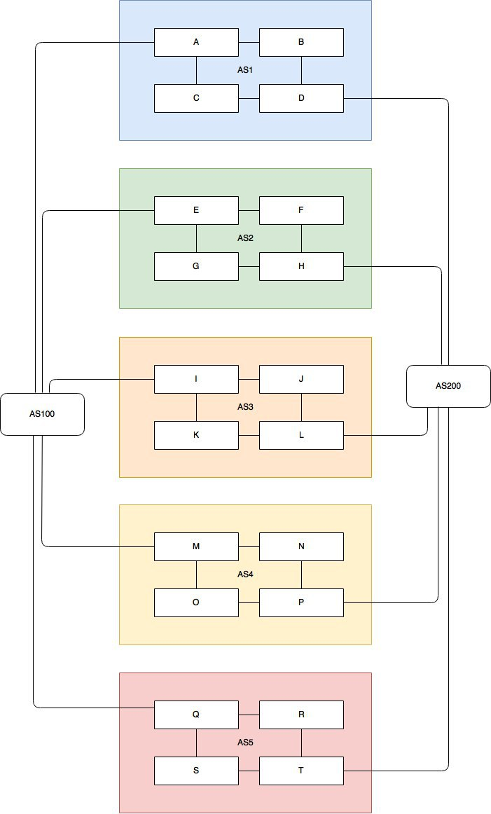

Slide 8
Exercise One

Slide 9
IPv4 Address Assignment
You already have an IP address for your router’s backbone link (A=.1, B=.2, …)
You have a /28 for your local network (PC and router connected back to back)
Assign your own host addresses from your /28 to your local network.

Slide 10
FreeBSD Network Interface Configuration
configure interface on Unix host
    ifconfig em0 inet n.n.n.n netmask m.m.m.m
(you need to be root to change the IP address)
  em0 is the interface name
  n.n.n.n is IP address
  m.m.m.m is netmask

Slide 11
Connect PC to router console port
Connect cable to console port on router, serial port on Unix box
Use the tip command to connect your keyboard and screen to the serial port
  e.g. bash$ tip com1
You may have to edit /etc/remote
See man pages for tip(1) and remote(5)
  HINT: to exit tip, type ~.

Slide 12
Cisco Router Network Interface Configuration
configure backbone interface on cisco router
conf t
interface fastethernet0/0
ip address n.n.n.n m.m.m.m
fastethernet0/0 is interface name
n.n.n.n is IP address
m.m.m.m is netmask
Now configure the local interface on your router that connects to your PC (ie. Fa0/1). Use the IP address assignments that you made 3 slides ago.

Slide 13
Cisco Router Network Interface Configuration
Cisco global config should always include:
ip classless
ip subnet-zero
ip cef
Cisco interface config should usually include:
no shutdown
no ip proxy-arp
no ip redirects
no ip directed-broadcast

Slide 14
Forwarding Tables at this point in the exercise
fa0/1
fa0/0
fa0/0
fa0/1
Your
PC
Your
Router
Their
Router
Their
PC
Destination: Next Hop
Your subnet: Connected
(no default)
Destination: Next Hop
Their subnet: Connected
(no default)
Destination: Next Hop
Your subnet: Connected (fa0/1)
Backbone subnet: Connected (fa0/0)
(no default or anything else)
Destination: Next Hop
Their subnet: Connected (fa0/1)
Backbone subnet: Connected (fa0/0)
(no default or anything else)

Slide 15
Test Connectivity
PC can ping local interface of router
Router can ping PC
Router can ping other routers
PC cannot ping backbone interface of router
PC cannot ping other routers or other PCs
Router cannot ping other PCs.

Slide 16
Configure a default route
Add route on PC
route add default g.g.g.g
g.g.g.g is the IP address of your gateway, which will be the IP address of your router's interface to your subnet. (Don't use your router's backbone IP address.)
Display forwarding table
netstat -rn

Slide 17
Forwarding Tables at this point in the exercise
fa0/1
fa0/0
fa0/0
fa0/1
Your
PC
Your
Router
Their
Router
Their
PC
Destination: Next Hop
Your subnet: Connected
Default: Your router
Destination: Next Hop
Their subnet: Connected
Default: Their router
new
new
Destination: Next Hop
Your subnet: Connected (fa0/1)
Backbone subnet: Connected (fa0/0)
(no default or anything else)
Destination: Next Hop
Their subnet: Connected (fa0/1)
Backbone subnet: Connected (fa0/0)
(no default or anything else)

Slide 18
Test connectivity
All PCs should now be able to reach the backbone IP address of their own routers.
But, you still can’t reach other PCs, or other routers.
  why?

Slide 19
When you ping their router...
PING
src = Your PC
dst = Their Router (backbone address)
REPLY
src = Their Router (backbone address)
dst = Your PC
3
1
2
Your
PC
Your
Router
Their
Router
Their
PC
Destination: Next Hop
Your subnet: Connected
Default: Your router
Destination: Next Hop
Their subnet: Connected
Default: Their router
1
Destination: Next Hop
Your subnet: Connected (fa0/1)
Backbone subnet: Connected (fa0/0)
(no default or anything else)
2
Destination: Next Hop
Their subnet: Connected (fa0/1)
Backbone subnet: Connected (fa0/0)
(no default or anything else)
3 ???

Slide 20
Configure static routes for the remaining classroom desks
On your router, add static routes to the other PCs, using their router's backbone IP addresses as the next-hop.
ip route n.n.n.n m.m.m.m g.g.g.g
n.n.n.n m.m.m.m is their subnet and netmask
g.g.g.g is their router's address on the backbone
Do this for every PC/router cluster in the class
  There are A LOT of them. Cut and paste?
Consult the map earlier to obtain the PC/router local subnet, and the corresponding router backbone IP address.

Slide 21
Forwarding Tables at this point in the exercise
fa0/1
fa0/0
fa0/0
fa0/1
Your
PC
Your
Router
Their
Router
Their
PC
Destination: Next Hop
Your subnet: Connected
Default: Your router
Destination: Next Hop
Their subnet: Connected
Default: Their router
Destination: Next Hop
Your subnet: Connected (fa0/1)
Backbone subnet: Connected (fa0/0)
Their subnet: Their router
Another subnet: Another router
(no default)
new
Destination: Next Hop
Their subnet: Connected (fa0/1)
Backbone subnet: Connected (fa0/0)
Your subnet: Your router
Another subnet: Another router
(no default)
new

Slide 22
Test Connectivity
All routers can reach all PCs
All PCs can reach all backbone IP addresses
All PCs can reach PCs in other rows
Test with traceroute

Slide 23
When your PC pings their PC...
PING
src = Your PC
dst = Their PC
1
2
3
Your
PC
Your
Router
Their
Router
Their
PC
Destination: Next Hop
Your subnet: Connected
Default: Your router
Destination: Next Hop
Their subnet: Connected
Default: Their router
1
Destination: Next Hop
Your subnet: Connected (fa0/1)
Backbone subnet: Connected (fa0/0)
Their subnet: Their router
Another subnet: Another router
(no default)
Destination: Next Hop
Their subnet: Connected (fa0/1)
Backbone subnet: Connected (fa0/0)
Your subnet: Your router
Another subnet: Another router
(no default)
3
2

Slide 24
… and the reply from their PC
PING
src = Your PC
dst = Their PC
REPLY
src = Their PC
dst = Your PC
6
5
4
1
2
3
Your
PC
Your
Router
Their
Router
Their
PC
Destination: Next Hop
Your subnet: Connected
Default: Your router
Destination: Next Hop
Their subnet: Connected
Default: Their router
4
Destination: Next Hop
Your subnet: Connected (fa0/1)
Backbone subnet: Connected (fa0/0)
Their subnet: Their router
Another subnet: Another router
(no default)
Destination: Next Hop
Their subnet: Connected (fa0/1)
Backbone subnet: Connected (fa0/0)
Your subnet: Your router
Another subnet: Another router
(no default)
6
5

Slide 25
Static Exercise using IPv6
Now let's repeat this exercise using IPv6 addressing
Consult addressing plan for IPv6 addresses
  Link between router and PC gets a /60
    Group A use 2001:43f8:220:10::/60
    Group B use 2001:43f8:220:20::/60
    etc
  Backbone is numbered from 2001:43f8:220:0::/64
    Group A use 2001:43f8:220:0::1/64
    Group Buse 2001:43f8:220:0::2/64

Slide 26
Big Hint!
If you are not using COPY/PASTE or the TFTP method to upload your config, you are wasting a lot of your time!

Slide 27
FreeBSD Network Interface Configuration
configure interface on Unix host
ifconfig em0 inet6 n:n:n:n/m
em0 is interface name
n:n:n:n is IPv6 address
m is netmask

Slide 28
Cisco Router Network Interface Configuration
Configure the backbone interface on your router
conf t
ipv6 unicast-routing
interface fastethernet0/0
ipv6 address n:n:n:n/m
fastethernet0/0 is interface name
n:n:n:n is IPv6 address
m is netmask
Now configure local (lan-facing) interface on your router too.

Slide 29
Cisco Router Network Interface Configuration
Cisco ipv6 global config should always include:
no ipv6 source-route
ipv6 cef
Cisco interface config should additionally include:
no ipv6 redirects

Slide 30
Configure a default route
Add route on PC
route add -inet6 default g:g:g:g
  g:g:g:g is IPv6 address of gateway (which is on Cisco router)
  -inet6 tells FreeBSD that this is an IPv6 route
Display forwarding table
netstat -rn

Slide 31
Configure static routes for the remaining classroom desks
On your router, add static routes to the other clusters, similar to how you did for ipv4.
  next hop is backbone interface of other row’s router
ipv6 route n:n:n:n/m g:g:g:g
Repeat several times until complete

Slide 32
Test Connectivity
All routers can reach all PCs
All PCs can reach all backbone IP addresses
All PCs can reach PCs in other rows
Test with traceroute

Slide 33
Exercise Two

Slide 34
Configure static routes to classroom router
On your router, remove all static routes
no ip route n.n.n.n m.m.m.m g.g.g.g
Repeat until complete
Add routes to all other groups' blocks
ip route n.n.n.n m.m.m.m g.g.g.g
Add a default route point to the SIE classroom router
  (next hop is backbone IP address of the SIE router)
ip route 0.0.0.0 0.0.0.0 g.g.g.g
Do the same for IPv6:
no ipv6 route n:n:n:n/m g:g:g:g
ipv6 route n:n:n:n/m g:g:g:g
ipv6 route ::/0 g:g:g:g

Slide 35
Test Connectivity
All routers can reach all PCs
All PCs can reach all backbone IP addresses
All PCs can reach PCs in other rows
Test with traceroute
  Test both IPv4 & IPv6
How is this working?
  All static routes have been added to the classroom router.

Slide 36
Edit FreeBSD's ‘/etc/rc.conf’ file
On production machines, add lines to /etc/rc.conf to preserve network settings on reboot
hostname="porcupine.tomato.example"
ifconfig_em0="inet X.X.X.X netmask Y.Y.Y.Y”
ipv6_ifconfig_em0="X:X:X:X prefixlen 64”
defaultrouter=”G.G.G.G”
ipv6_defaultrouter=”G:G:G:G"
See /etc/default/rc.conf for more information

Slide 37
Static Routing
Exercise
The End

